Slide 1
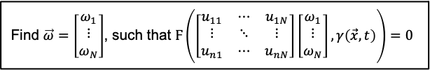
Find $\vec{ω}=\left[\begin{matrix}ω_{1} \\ ⋮ \\ ω_{N}\end{matrix}\right]$, such that $Ϝ\left(\left[\begin{matrix}u_{11} & ⋯ & u_{1N} \\ ⋮ & ⋱ & ⋮ \\ u_{n1} & ⋯ & u_{nN}\end{matrix}\right]\left[\begin{matrix}ω_{1} \\ ⋮ \\ ω_{N}\end{matrix}\right],γ\left(\vec{x},t\right)\right)=0$
PDE-CL

Slide 2
Partial Differential Equation Constrained Layer (PDE-CL) for Inverse Problems and Design
March 20, 2023

Slide 3




Physics-Informed Neural Network (PINN)
Neural Network
$$\vec{x},t$$
Solution: $u\left(\vec{x},t\right)$
Given Coefficients: $γ\left(\vec{x},t\right)$
Loss: ${ℒ=\left|Ϝ\left(u\left(\vec{x},t\right),γ\left(\vec{x},t\right)\right)\right|}^{2}$
Reference:
Raissi, M.; Perdikaris, P.; Karniadakis, G. E. Physics-Informed Neural Networks: A Deep Learning Framework for Solving Forward and Inverse Problems Involving Nonlinear Partial Differential Equations. Journal of Computational Physics 2019, 378, 686–707. https://doi.org/10.1016/j.jcp.2018.10.045.

Slide 4











PINNs for Inverse Problems
Direct (Possibly Noisy) Observations of Solution, $u\left(\vec{x},t\right)$
Neural Network 1
Solution: $\hat{u}\left(\vec{x},t\right)$
Measurement Loss: $ℸ={\left|\hat{u}\left(\vec{x},t\right)−u\left(\vec{x},t\right)\right|}^{2}$
$$\vec{x},t$$
Neural Network 2
PDE Loss: ${ℒ=\left|Ϝ\left(\hat{u}\left(\vec{x},t\right),γ\left(\vec{x},t\right)\right)\right|}^{2}$
Coefficients: $γ\left(\vec{x},t\right)$
Indirect, Noisy Observation of Solution, $M_{observed }$
Neural Network 1
Emulate Noisy Measurement
Get Distribution $P\left(M\right)$
Measurement Loss: $ℸ=\log{P\left(M_{observed }\right)}$
Solution: $\hat{u} \left(\vec{x},t\right)$
$$\vec{x},t$$
Neural Network 2
PDE Loss: ${ℒ=\left|Ϝ\left(\hat{u}\left(\vec{x},t\right),γ\left(\vec{x},t\right)\right)\right|}^{2}$
Coefficients: $γ\left(\vec{x},t\right)$
Total Loss: $μℒ+ℸ$, where the weight $μ$ is chosen as a hyperparameter
Reference:
Chen, Y.; Lu, L.; Karniadakis, G. E.; Dal Negro, L. Physics-Informed Neural Networks for Inverse Problems in Nano-Optics and Metamaterials. Opt. Express 2020, 28 (8), 11618. https://doi.org/10.1364/OE.384875.

Slide 5


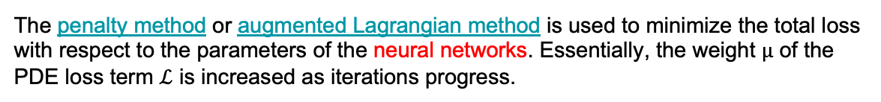




PINN with Hard Constraints for Inverse Design (hPINN)
Neural Network 1
Design Loss: $ℸ\left(u\left(\vec{x},t\right),γ\left(\vec{x},t\right)\right)$
Solution: $u\left(\vec{x},t\right)$
$$\vec{x},t$$
Neural Network 2
PDE Loss: ${ℒ=\left|Ϝ\left(u\left(\vec{x},t\right),γ\left(\vec{x},t\right)\right)\right|}^{2}$
Coefficients: $γ\left(\vec{x},t\right)$
Total Loss: $μℒ+ℸ$
The penalty method or augmented Lagrangian method is used to minimize the total loss with respect to the parameters of the neural networks. Essentially, the weight $μ$ of the PDE loss term $ℒ$ is increased as iterations progress.
Reference:
Lu, L.; Pestourie, R.; Yao, W.; Wang, Z.; Verdugo, F.; Johnson, S. G. Physics-Informed Neural Networks with Hard Constraints for Inverse Design. SIAM J. Sci. Comput. 2021, 43 (6), B1105–B1132. https://doi.org/10.1137/21M1397908.

Slide 6
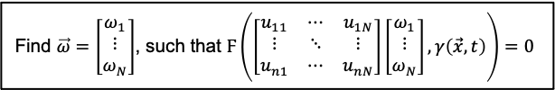

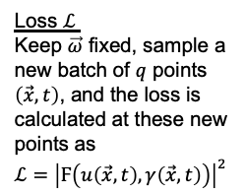



Partial Differential Equation Constrained Layer (PDE-CL)
Implicit Layer
Neural Network
Solution basis: $u_{i}\left(\vec{x},t\right)$
$N$ values per batch dim
$n × N$ values
Find $\vec{ω}=\left[\begin{matrix}ω_{1} \\ ⋮ \\ ω_{N}\end{matrix}\right]$, such that $Ϝ\left(\left[\begin{matrix}u_{11} & ⋯ & u_{1N} \\ ⋮ & ⋱ & ⋮ \\ u_{n1} & ⋯ & u_{nN}\end{matrix}\right]\left[\begin{matrix}ω_{1} \\ ⋮ \\ ω_{N}\end{matrix}\right],γ\left(\vec{x},t\right)\right)=0$
$$u=\left[\begin{matrix}u_{11} & ⋯ & u_{1N} \\ ⋮ & ⋱ & ⋮ \\ u_{n1} & ⋯ & u_{nN}\end{matrix}\right]\left[\begin{matrix}ω_{1} \\ ⋮ \\ ω_{N}\end{matrix}\right]$$
$$\vec{x},t,γ\left(\vec{x},t\right)$$
batch dim $n$
Loss $ℒ$
Keep $\vec{ω}$ fixed, sample a new batch of $q$ points $\left(\vec{x},t\right)$, and the loss is calculated at these new points as ${ℒ=\left|Ϝ\left(u\left(\vec{x},t\right),γ\left(\vec{x},t\right)\right)\right|}^{2}$
Reference:
Négiar, G.; Mahoney, M. W.; Krishnapriyan, A. S. Learning Differentiable Solvers for Systems with Hard Constraints. The Eleventh International Conference on Learning Representations, 2023. https://openreview.net/forum?id=vdv6CmGksr0

Slide 7

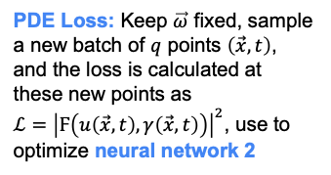
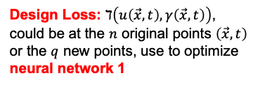
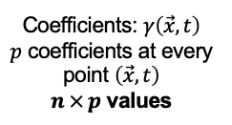


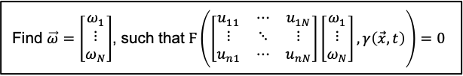
Inverse Design with PDE-CL
Coefficients: $γ\left(\vec{x},t\right)$
$p$ coefficients at every point $\left(\vec{x},t\right)$
$n × p$ values
Solution basis: $u_{i}\left(\vec{x},t\right)$
$N$ values per batch dim
$n × N$ values
Neural Network 1
Neural Network 2
$$\vec{x},t$$
batch dim $n$
Implicit Layer
Find $\vec{ω}=\left[\begin{matrix}ω_{1} \\ ⋮ \\ ω_{N}\end{matrix}\right]$, such that $Ϝ\left(\left[\begin{matrix}u_{11} & ⋯ & u_{1N} \\ ⋮ & ⋱ & ⋮ \\ u_{n1} & ⋯ & u_{nN}\end{matrix}\right]\left[\begin{matrix}ω_{1} \\ ⋮ \\ ω_{N}\end{matrix}\right],γ\left(\vec{x},t\right)\right)=0$
$$u=\left[\begin{matrix}u_{11} & ⋯ & u_{1N} \\ ⋮ & ⋱ & ⋮ \\ u_{n1} & ⋯ & u_{nN}\end{matrix}\right]\left[\begin{matrix}ω_{1} \\ ⋮ \\ ω_{N}\end{matrix}\right]$$
Design Loss: $ℸ\left(u\left(\vec{x},t\right),γ\left(\vec{x},t\right)\right)$, could be at the $n$ original points $\left(\vec{x},t\right)$ or the $q$ new points, use to optimize neural network 1
PDE Loss: Keep $\vec{ω}$ fixed, sample a new batch of $q$ points $\left(\vec{x},t\right)$, and the loss is calculated at these new points as ${ℒ=\left|Ϝ\left(u\left(\vec{x},t\right),γ\left(\vec{x},t\right)\right)\right|}^{2}$, use to optimize neural network 2
Compare design loss and PDE loss to that achieved by hPINN
Should we jointly optimize neural network 1 and neural network 2 or alternate training?

Slide 8
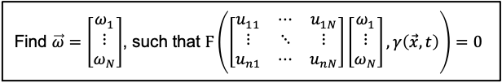


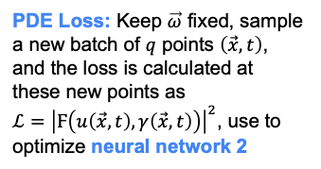

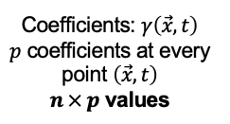



Inverse Problem with PDE-CL
Coefficients: $γ\left(\vec{x},t\right)$
$p$ coefficients at every point $\left(\vec{x},t\right)$
$n × p$ values
Solution basis: $u_{i}\left(\vec{x},t\right)$
$N$ values per batch dim
$n × N$ values
Neural Network 1
Neural Network 2
$$\vec{x},t$$
batch dim $n$
Implicit Layer
Find $\vec{ω}=\left[\begin{matrix}ω_{1} \\ ⋮ \\ ω_{N}\end{matrix}\right]$, such that $Ϝ\left(\left[\begin{matrix}u_{11} & ⋯ & u_{1N} \\ ⋮ & ⋱ & ⋮ \\ u_{n1} & ⋯ & u_{nN}\end{matrix}\right]\left[\begin{matrix}ω_{1} \\ ⋮ \\ ω_{N}\end{matrix}\right],γ\left(\vec{x},t\right)\right)=0$
$$u=\left[\begin{matrix}u_{11} & ⋯ & u_{1N} \\ ⋮ & ⋱ & ⋮ \\ u_{n1} & ⋯ & u_{nN}\end{matrix}\right]\left[\begin{matrix}ω_{1} \\ ⋮ \\ ω_{N}\end{matrix}\right]$$
PDE Loss: Keep $\vec{ω}$ fixed, sample a new batch of $q$ points $\left(\vec{x},t\right)$, and the loss is calculated at these new points as ${ℒ=\left|Ϝ\left(u\left(\vec{x},t\right),γ\left(\vec{x},t\right)\right)\right|}^{2}$, use to optimize neural network 2
Emulate Noisy Measurement
Get Distribution $P\left(M\right)$
Measurement Loss: $ℸ=\log{P\left(M_{observed }\right)}$, use to optimize neural network 1
Compare design loss and measurement loss to that achieved by PINN with soft constraint
Should we jointly optimize neural network 1 and neural network 2 or alternate training?

Slide 9
Comparison with Institut Fresnel Data
SEAGLE
Variant of SEAGLE with implicit differentiation
PINN Inverse Problem
hPINN Inverse Problem
PDE-CL Inverse Problem

Slide 10






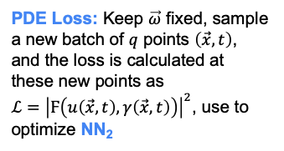






Joint Inverse Problems with PDE-CL
Have noisy, sparse, observed measurements $M_{1},M_{2}…M_{k}$ on PDE solutions $u_{1},u_{2}…u_{k}$. Each $u_{i}$ corresponds to a PDE of the same family, but with different, unknown coefficients $γ_{i}$. The coefficients $γ_{i}$ are assumed to be drawn from some unknown prior distribution. A variational autoencoder is trained to jointly determine $γ_{1},γ_{2}…γ_{k}$.
Latent Space $z$
$$\vec{x},t$$
Neural Network Encoder
Prior Distribution $P\left(z\right)$
Neural Network Decoder
Implicit Layer
$$M_{i}$$
$$Q\left(z\right)≈P\left(z | i \right)$$
NN₁
$$γ\left(\vec{x},t\right)$$
NN₂
Solution basis: $u_{i}\left(\vec{x},t\right)$
$$u\left(\vec{x},t\right)$$
Emulate Noisy Measurement
KL divergence:
$$D_{KL}\left(Q\left(z\right)||P\left(z\right)\right)$$
PDE Loss: Keep $\vec{ω}$ fixed, sample a new batch of $q$ points $\left(\vec{x},t\right)$, and the loss is calculated at these new points as ${ℒ=\left|Ϝ\left(u\left(\vec{x},t\right),γ\left(\vec{x},t\right)\right)\right|}^{2}$, use to optimize NN₂
Get Distribution $P\left(M\right)$
Measurement Loss: $ℸ=\log{P\left(M_{i}\right)}$
VAE Loss: $D_{KL}+$ $ℸ$, use to optimize the Neural Network Encoder and Neural Network Decoder
Compare to solving an inverse problem with a single $M_{i}$

